Slide 1
Project Gladiator-Home Loans
A Web Application based on ASP .NET Core Web API and Angular.

Slide 2
Team Members
S no. | Member Name | Ps number
1.(Team Lead) | Priyanshi Soni | 10683821
2. | Suhani Garg | 10684223
3. | Sagar Sidhwa | 10684142

Slide 3
Introduction
The Problem Statement and our take on it.
Buying a house is a dream for many and it involves lot of financial planning. While availing for home loans is quite a cumbersome process and can take a lot of time. Therefore to make this dream come true in an easier and more systematic way without paying visits to bank we present you our hassel-free and user-friendly web application based on ASP.NET Core Web API and Angular.
This platform lets user apply for Loan based on his requirements, calculate EMI based on amount, interest and tenure, Calculate the loan amount they are eligible for, Track his Loan Application,View his previous records, Check Loan Status and Account Balance.
Furthermore the application extends to admin and lets a admin access all the applications submitted by user, view and verify the details submitted and finally approve or reject the loan.
Today we will take you over to all the modules of our application Home Loan and show you how this application improves user experience.

Slide 4
Technologies Used
ASP .NET Core Web API
My SQL server
Angular
HTML
CSS
Bootstrap
GitHub
Azure Boards

Slide 5
Agile Methodology
Project RoadMap Creation: Deciding the basic approach to the project. Pointing out the requirements and how we need to tackle them. Also deciding the database schema.
Sprint Planning: Dividing the tasks into sprints and completed them within given time frame.
Daily meet with the whole team: To ensure what all work is done and what is left. Also to be aware of what other member is working on.
Sprint Reviews: reviewing each sprint once completed and planning the further strategy for the impediments.

Slide 6
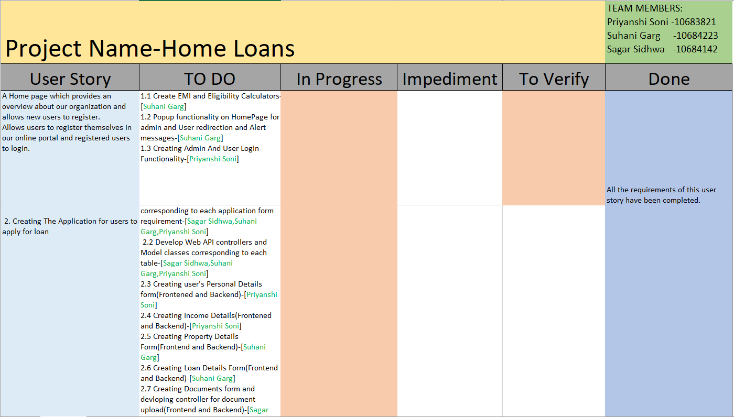
Scrum Board

Slide 7
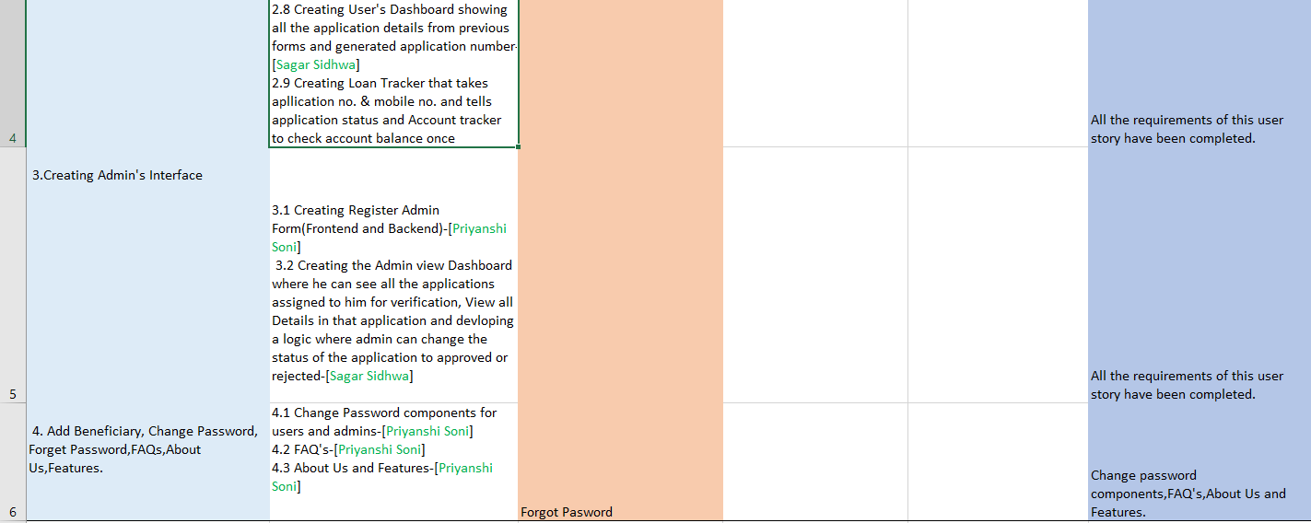

Slide 8
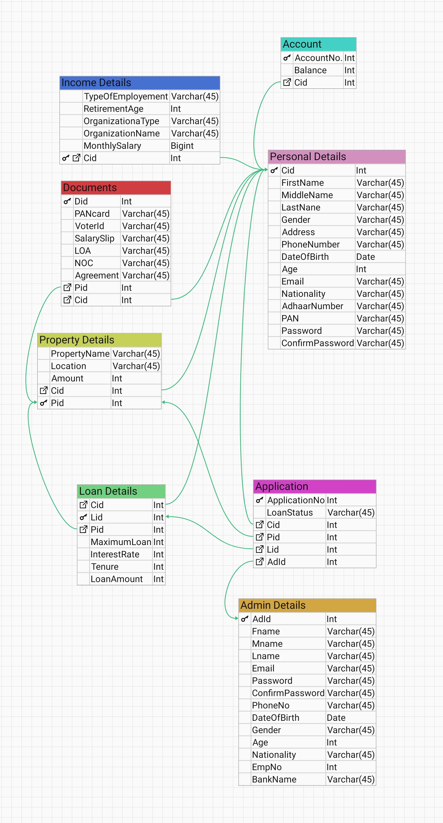
Database Schema

Slide 9
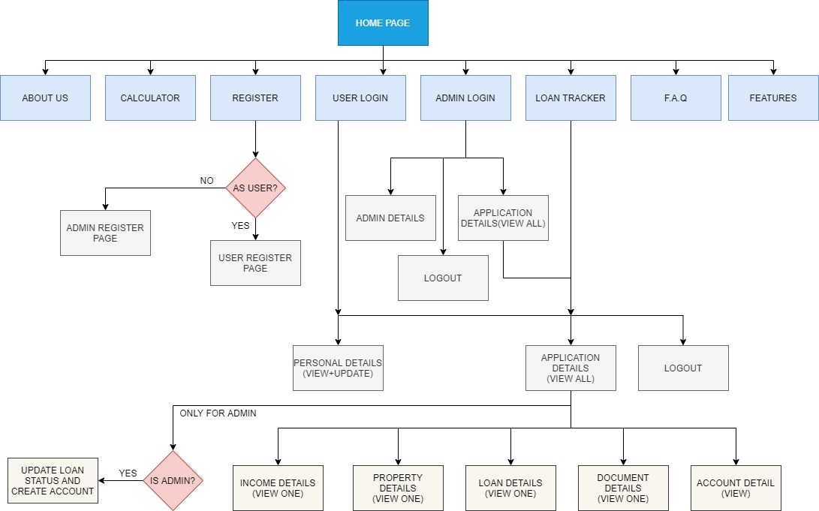
Application Flowchart

Slide 10
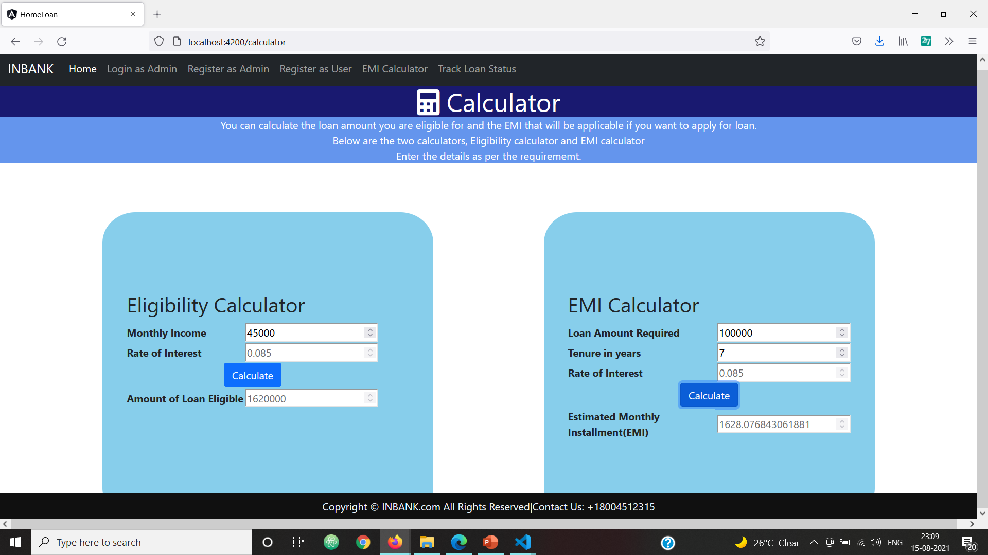
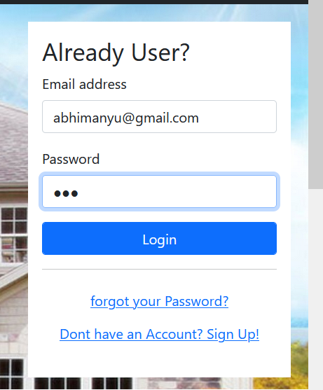
Our Interface

Slide 11
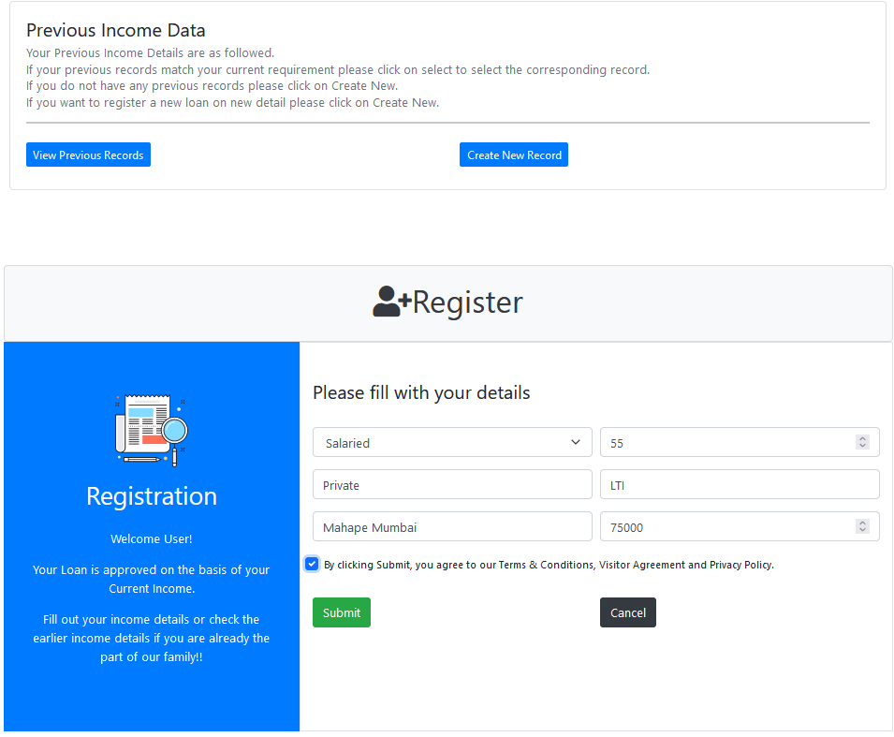
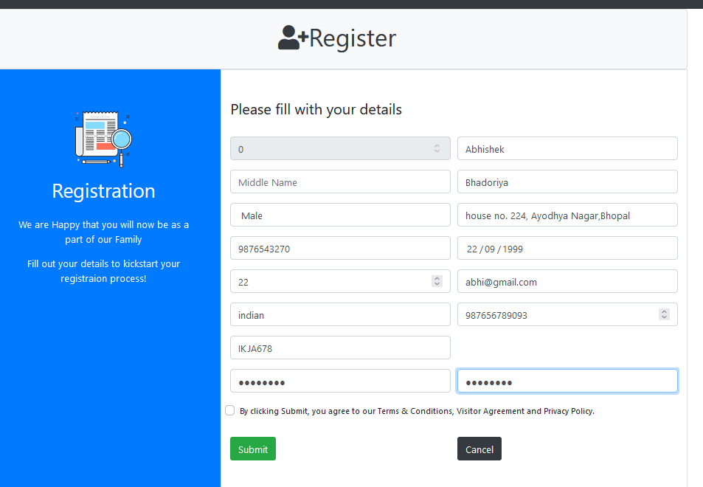
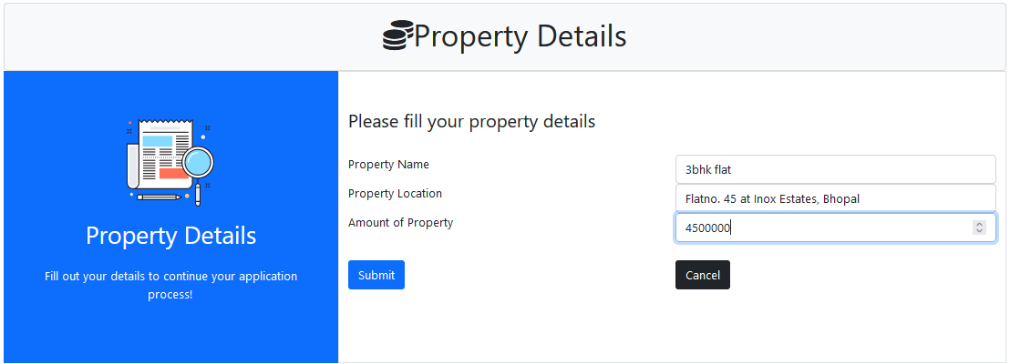
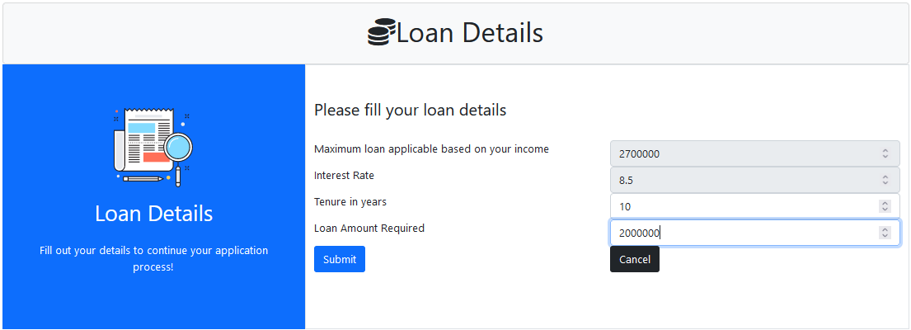

Slide 12
